Slide 1

Data Visualization Research Presentation
Group 10
Paul Alvarado (PXA200012)
Shriya Gajbhiye (SRG200001)
Kamalesh Muthu (KXM210108)
Shekhar Subedi (SXS200176)
Unnati Trivedi (UXT200000)
MIS 6380 – Summer 2022 – Dr. Nasar Islam

Slide 2


Science on the Map
By Mark Zastrow

Slide 3

Cartography and its Importance
Cartography is the discipline dealing with the conception, production, dissemination and study of maps
As a way of recording and storing information’s (environment, location, assets, people, etc.)
As a means of analyzing locational distributions and spatial patterns
As a method of presenting information and communicating findings
Without maps we are spatially blind

Slide 4
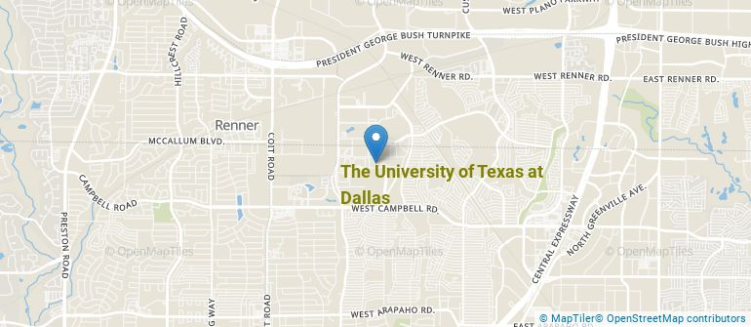
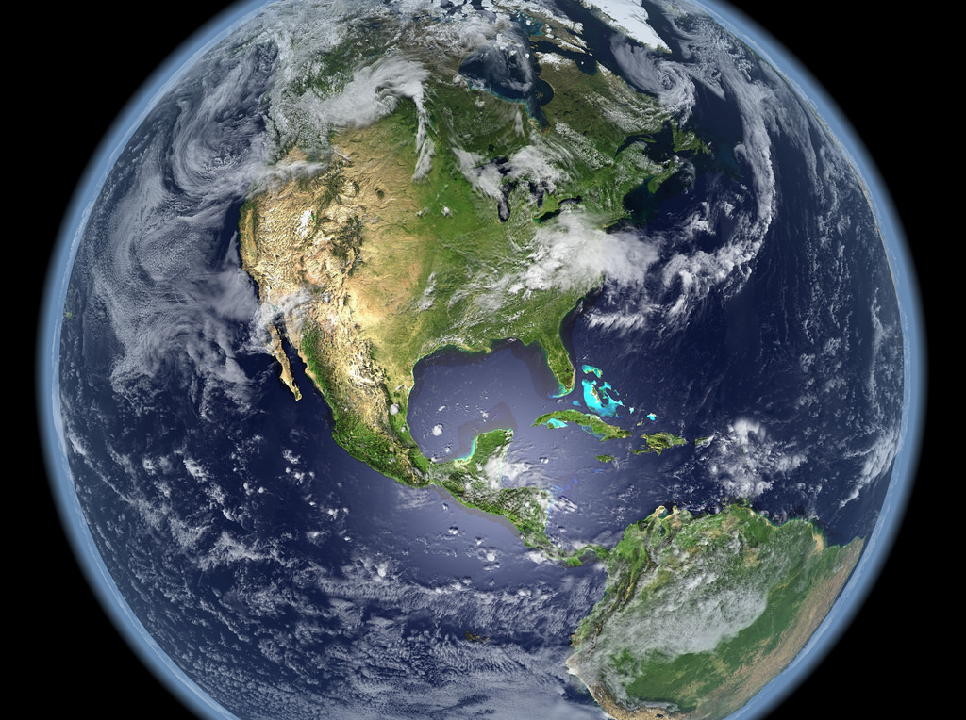
Map in Modern Times
The rise of geospatial- technology has evolved maps more significantly. One example of groundbreaking is with the development of Google earth.
Maps are more like visualizations, which are not the maps in the traditional senses, are getting more smarter, and showing us the world under various parameters. This proves that we have now many ways of presenting geospatial locations.
The techniques of using MS paint, quick sketches over an atlas, writing on google maps images etc. is replaced by new techniques like Tile Mill , Carto DB etc.

Slide 5
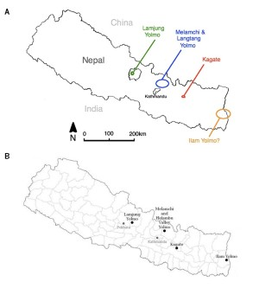
A Great Leap on Cartography: From MS Paint to TileMill Map
MAP A: MS Paint Map
Map B: TileMill Map
Disadvantage
Hard to produce map and distinguish each dialect’s geographical origin
Used to create still images on base maps
Advantages
Primarily intended for drawing and designing static maps
More approachable for novices than the conventional geographic information systems (GISs) that geographers have long used for analysis of geospatial data sets
They allow non-specialists to easily visualize, manipulate and share their data in formats that are as slickly browsable as Google Maps but with greater power and flexibility

Slide 6

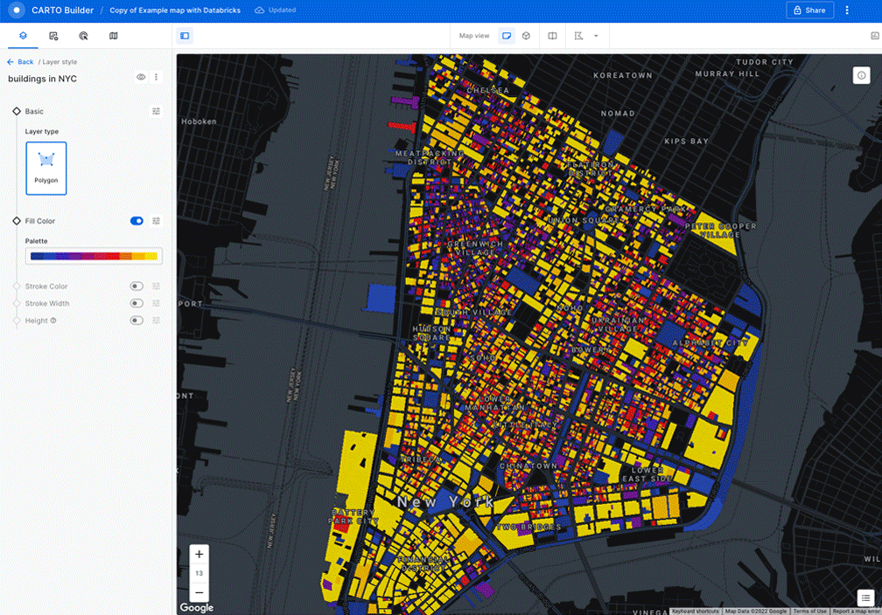
Carto DB (Dynamic)
Specializes in visualizing dynamic layers of data on top of base maps
Users can import their geo-located data into Carto DB's web-based interface and then filter or cluster data points
Advantages:
Can create and share a visualization in minutes. Being able to simply send a link to the map online also makes it much faster to point out data-quality issues.
The selection of global base maps
Easy filters, colors and symbols, and animation

Slide 7

Issues with Data Storage
Cost of data storage is a potential stumbling block for scientists with large data sets
Hosting map data on the company server could cost up to $100 per terabyte
Mapbox – offers 3D visualizations while Carto only provide static visualization – works with a similar pricing model for hosting maps on its servers, although TileMill itself is a free, downloadable program
However, CartoDB does work with academic users and provide grants to researchers to promote academic usage of their software

Slide 8



Ultimate Solutation
Combining these tools together could help make a greater visualization:
Using these tools togethers like basemaps in TileMill and data layers in CartoDB, then wrap them in an outline interface using leaflet.
Leaflet: is an online interface , a mobile freindly visualization package which runs in javaScripts, and meshes with packeages like D3.
Using CartoDB account with Github repository:
CartoDB account: Store data sets and access them
by SQL for other online apps like D3.
GitHub: the source codes can be stored in repository GitHub, but maps pulls the data from cartoDB account.
Limitations
The level of computational analysis is limited

Slide 9


Overcoming to Combined Storage Limitations
ArcGIS: A powerful GIs platform, a products by Esri, useful for urban planning and Crisis mapping etc., gives high level of computational analysis.
QGIS: An open-source alternatives for ArcGis , shows high level of computational analysis and visualization both.
Certain programming languages have mapping packages as well. For example, Python or R could be used to build a unique map visualization

Slide 10


Coding: A Part of Work for Maps
Python and R:
Advanced programming languages, used by researchers who wrote codes as part of their work
They have associated mapping packages from their libraries
Python pack-age matplotlib is one of the used package to create the scientific visualization software to make maps.
They are highly computational, analytics and shows high degree of visualization

Slide 11

Programming Language Limitations
The program experts are needed on programming like python and R to lead maps unlike Cartodb and TileMill, made expensive from the view of programmer’s cost
The cartodb and Tilemill are user friendly where it helps to accomplish a lot without programming knowledges

Slide 12
The Rise of Social Graphs for Business
By Sangeet Paul Choudary

Slide 13

Who Uses Social Media?
4.48 billon people currently use social media worldwide*
Up more than double from 2.07 billion in 2015
72.3% of the total US population actively use social media
*As of September 2, 2021

Slide 14
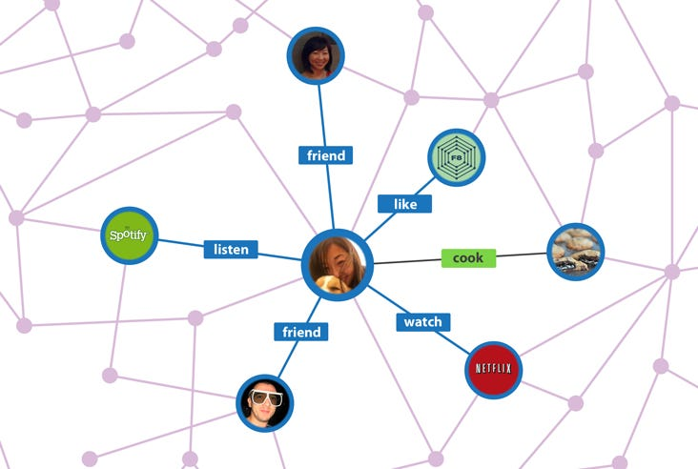
What is a Social Graph?
Social media gathers knowledge about each person’s social connections
A depiction of the network of friends and varying strengths of those relationships

Slide 15
Social Media as a Business Model
Early social media focused on social activity among account holders by creating better tools to manage their relationships
Today, social networks see social tools not as a product but to acquire data
Facebook saw opportunity to produce a higher-level intelligence layer that would be useful to other businesses
Allowed highly target services

Slide 16
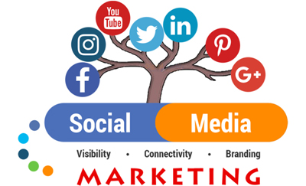
How Social Media is Helping Businesses
Marketing and Advertisement
Customer Sentiment Analysis
Customer Service
Sales
Recruiting and Hiring
Crisis management
Notes:
Paul

Slide 17

Role of Social Graphs in Helping Businesses
Social graph makes it possible to make personalized recommendations to you, and everyone else based on the data collected.
For example, many companies like TripAdvisor and Trivago leverage Facebook’s social graph to ensure that, when you are looking for reviews of hotels, restaurants, and so forth, any reviews posted by people you know appear right at the top.
Notes:
Paul

Slide 18
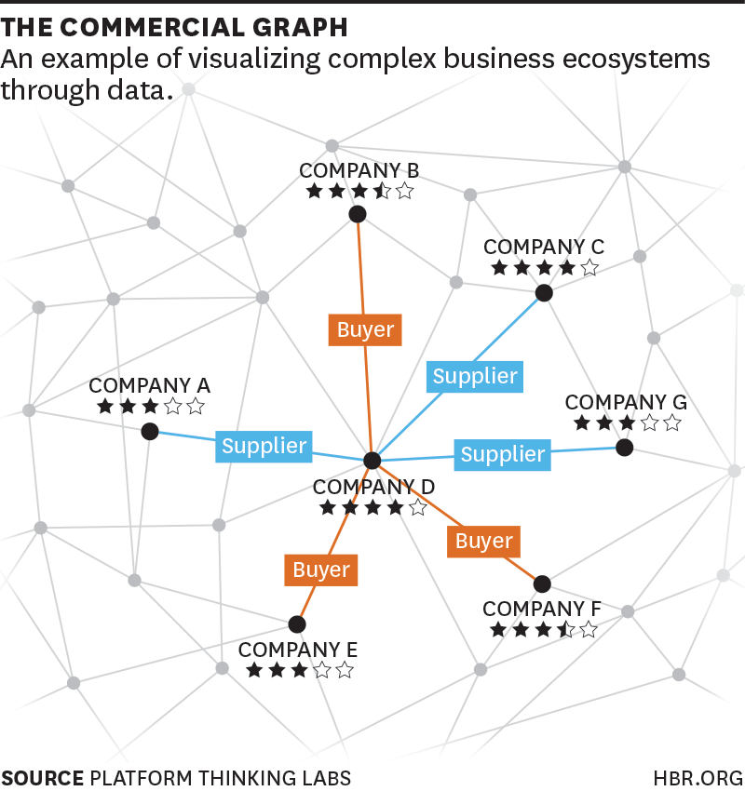
Commercial Graphs
Commercial graph is used for visualizing complex business ecosystem through data
It visually displays three things: Companies, Relationship, Reputation
In commercial graphs company does not have to opt to join a network for it to be included in a commercial graph. Instead, its connections to others can be derived from interactions recorded by other companies
The main source of value for commercial graph is the ability to depict each party’s earned reputation.
Commercial graph rely on implicit indicators of quality and performance which can be observed between companies.
Commercial graph help companies assess the performance of their business relationships
Notes:
Paul
>Commercial graphs visually display three things: the companies in an ecosystem, the relationships among them, and the reputations they have earned through their mutual dealings. As with social graphs, the depiction of the nature and strength of relationships between companies is based on actual interaction data. Unlike with a social graph, a company does not have to explicitly opt to join a network for it to be included in a commercial graph. Instead, its connections to others can often be derived from interactions recorded by other companies.
>The commercial graph’s ability to depict each party’s earned reputation is its main source of value. A company’s reputation score is based on its performance across multiple business relationships. Also commercial graphs don’t rely on explicitly stated opinions submitted through social mechanism. Instead, they rely on implicit indicators of quality and performance, which can be objectively observed in the business interactions between companies, and consistently weighted in the scoring.
>When aggregated across an industry, these data add up to commercial graphs which can help companies assess the performance of their business relationships vis a vis industry averages. They help managers identify new partners and suppliers who are likely to outperform current ones. And they help companies benchmark their own performance against peers.

Slide 19
The Value of Commercial Graphs
Depiction of a company’s earned reputation
Provide industry-wide assessment of performance for individual companies
Help managers identify new and superior partners and suppliers
Notes:
Paul
Depiction of a company’s earned reputation - Rely on objectively observed quality and performance indicators

Slide 20
Business Opportunity
The Facebook equivalent for commercial graphs
Once created, software can easily be replicated and improved
Shared interest to converge on one platform due to power of networking

Slide 21

Current State of Commercial Graphs
Several companies already capture interaction data through workflow management
TradeShift
Procurify
SPS Commerce
They recognize that software is not the end product, but a means to acquire data to produce commercial graphs
Software as a Service (SAAS)

Slide 22

The Future
Other providers are eyeing new opportunities
LinkedIn’s Sales Navigator
Square and Pulse App – capture transaction data for small businesses
Commerce flows on networks – the rise of commercial graphs will be rapid
A layer of intelligence for more efficient market interactions and business interactions will be required

Slide 23

References
https://carto.com/
www.anthillonline.com/last-data-storage-easy-turning-tab/
github_PNG28.png (1373×1373) (pngimg.com)
arcgis-1024x512-20191030.png (1024×512) (thesmbguide.com)
https://www.bing.com/images
CARTO | Location Intelligence & GIS for Cloud Natives
googleearth-1.jpg (1024×1008) (newswatchtv.com)
Data visualization: Science on the map | Nature
https://hbr.org/2015/02/the-rise-of-social-graphs-for-businesses
https://umaine.edu/undiscoveredmaine/small-business/resources/marketing-for-small-business/social-media-tools/social-media-statistics-details/
https://www.businessinsider.com/explainer-what-exactly-is-the-social-graph-2012-3

Slide 24

Questions

